Slide 1
Simple Linear Regression
Weight prediction with height

Slide 2
Algorithm :
Step1 : import all the required python inbuilt libraries
Step2 : load the data as a dataframe
Step3 : create model with with loaded data
Step4 : make a dataset to check model performance, which has only independent variable(Height)
Step5 : find the target variable with independent variable(Height)

Slide 3
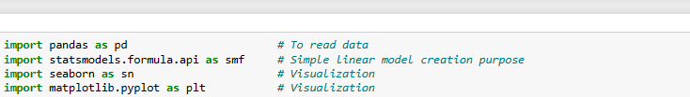
Importing libraries

Slide 4
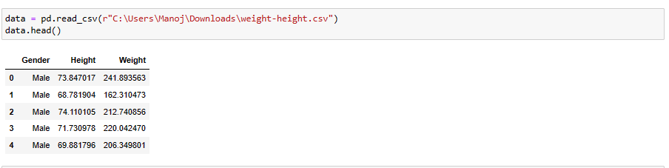
Loading dataset

Slide 5
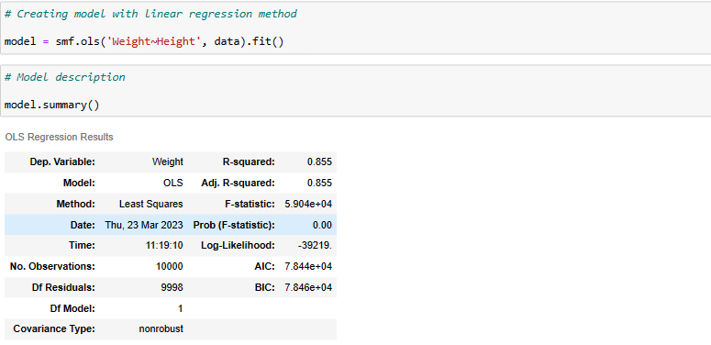
Model creation

Slide 6
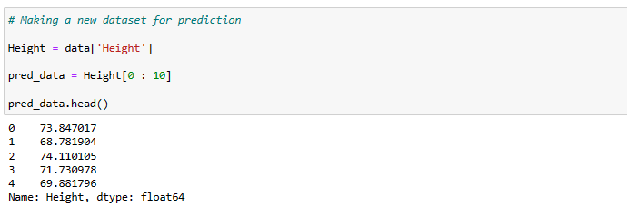
Creating new dataset for prediction

Slide 7
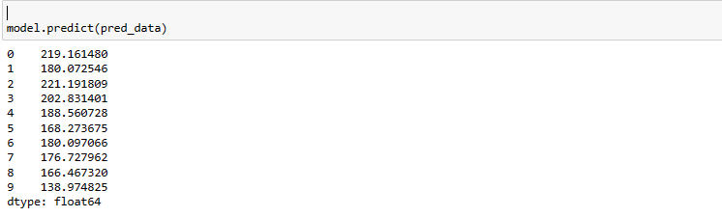
Prediction

